Slide 1
Reason 3
For using the bomb

Slide 2
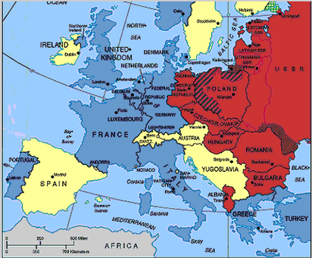
To Impress the Soviets
With the end of the war nearing, the Soviets were an important strategic consideration, especially with their military control over most of Eastern Europe.

Slide 3
Side Benefit
However, this idea is thought to be more appropriately understood as side benefit or side effect of dropping the bomb and not so much its sole purpose.

Slide 4
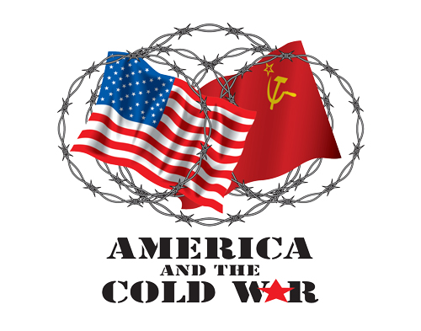
An End and a Beginning
The events in Japan, although they brought a close to World War II, marked the beginning of the Cold War between the United States and the Soviet Union. It would last four decades and once again change the world.
Notes:
http://www.fordlibrarymuseum.gov/museum/exhibits/ColdWar/main.html

Slide 5

No Peace
World War II was the most devastating conflict in history with much of Europe and Asia left in ruins at war's end. Yet, there was no peace.

Slide 6
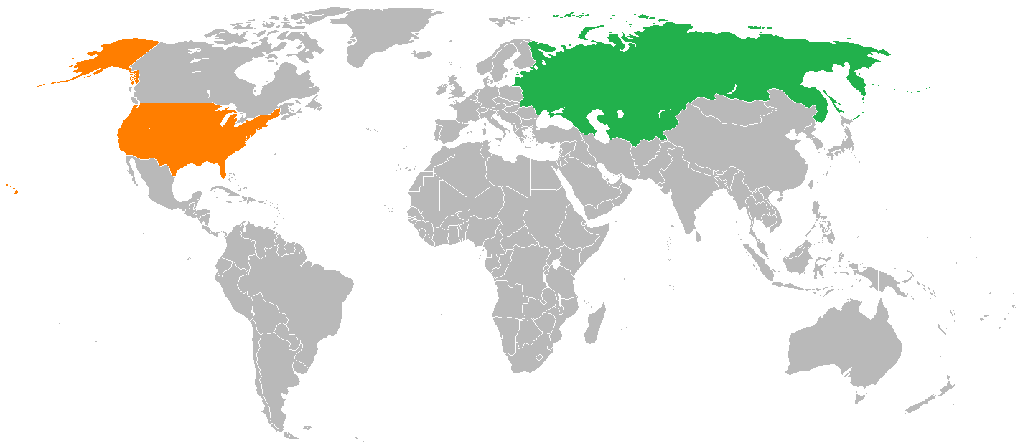
The superpowers of the United States and Soviet Union and their beliefs of democracy versus tyranny competed for prominence on the world stage in a cold war.
For over 40 years these nuclear superpowers maintained a standoff and avoided a hot war that could have potentially destroyed the planet.

Slide 7
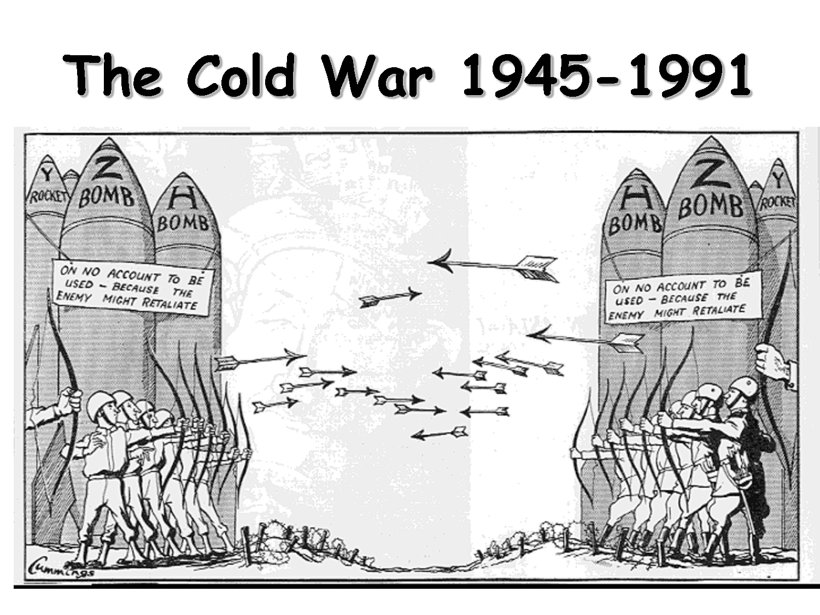

Slide 8
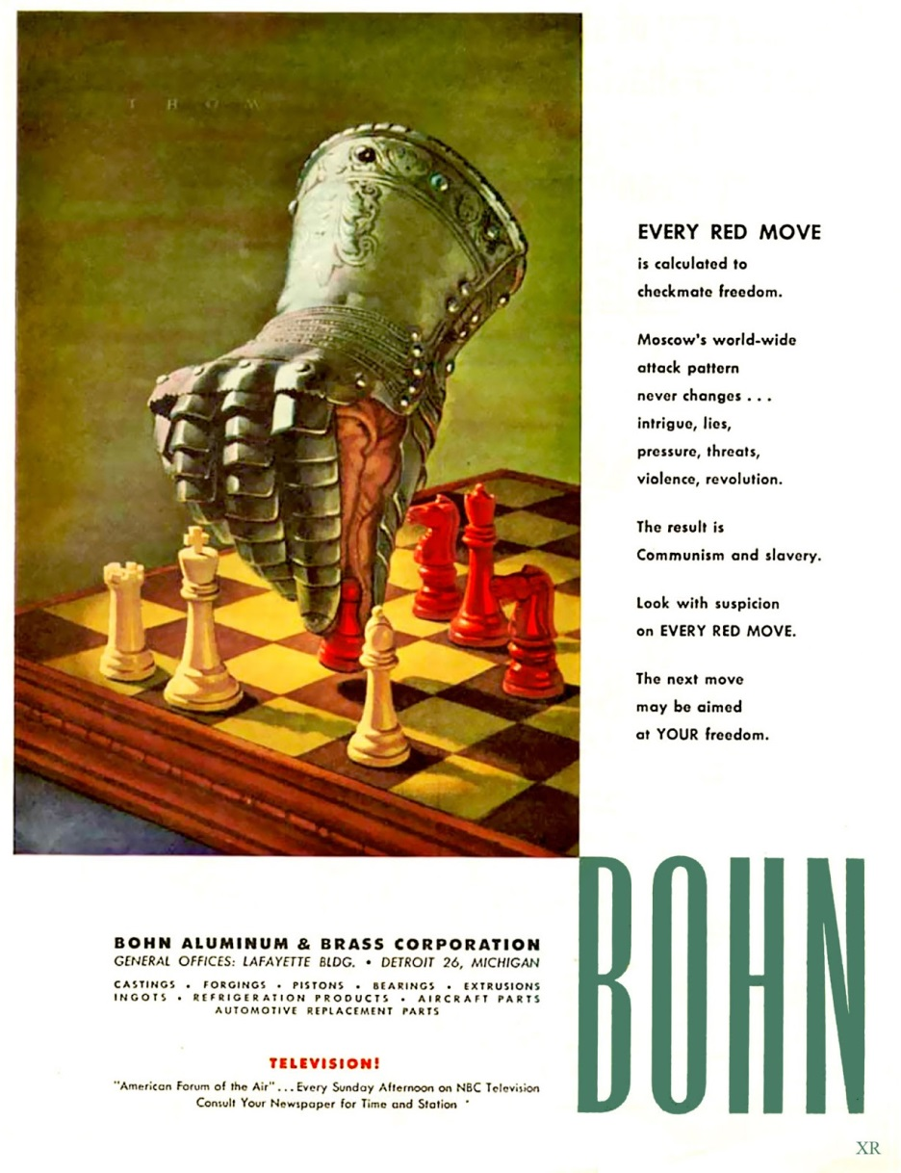
Anything You Can Do, We Can Do Bigger!
Between 1945 and the late 1980s, both sides invested huge amounts of money in nuclear weapons and increased their stockpiles significantly, mostly as a means to deter (discourage) conflict. The threat of catastrophic destruction from The Bomb loomed over everyone and everything.
Notes:
1950's ... anti-communism: advertising! Image via: http://atomic-annhilation.blogspot.com/2013_07_01_archive.html

Slide 9
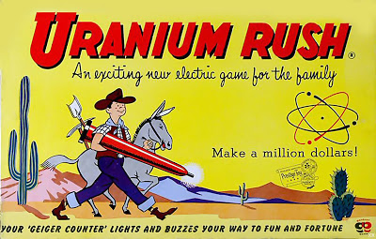
Gold Uranium Rush?
As the USA feverishly worked to build huge stockpiles of atomic weapons the need to find and mine Uranium ore skyrocketed. Modern day prospectors set out for 'them thar hills!' in a 'uranium rush'. Deposits of the mildly radioactive ore ( it had to be refined many times for bomb production) were plentiful in North America. Less so in the Soviet Union.
Notes:
Image via: http://atomic-annhilation.blogspot.com/2013_07_01_archive.html All Rights Reserved.

Slide 10
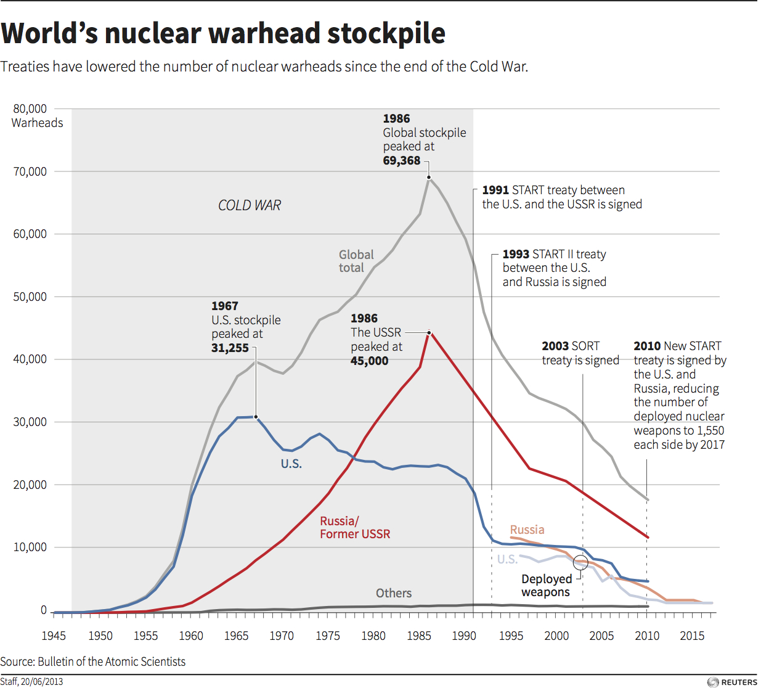

Slide 11
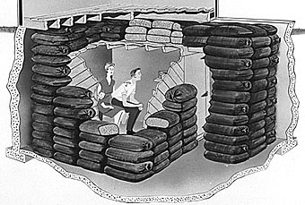
Schools conducted nuclear air raid drills. Governments built fallout shelters. Homeowners dug bunkers in their backyards and stocked them with food, power, and games like Monopoly to prevent boredom.
Notes:
Artist's rendition of temporary basement fallout shelter, 1957. Source - NARA, NWDNS-311-D-14(1) http://www.nebraskastudies.org/0900/frameset_reset.html?http://www.nebraskastudies.org/0900/stories/0901_0132.html

Slide 12

According to the United States Library of Congress this movie was seen by millions of schoolchildren from the early 1950's until 1991. Made with the help of schoolchildren from New York City and Astoria, New York, it was shown in schools as the cornerstone of the government's "duck and cover" public awareness campaign.
https://www.youtube.com/watch?v=IKqXu-5jw60 or
http://www.teachertube.com/video/civil-defense-duck-and-cover-28958 or
http://www.schooltube.com/video/17cd4122606644e5927a/Duck%20and%20Cover

Slide 13
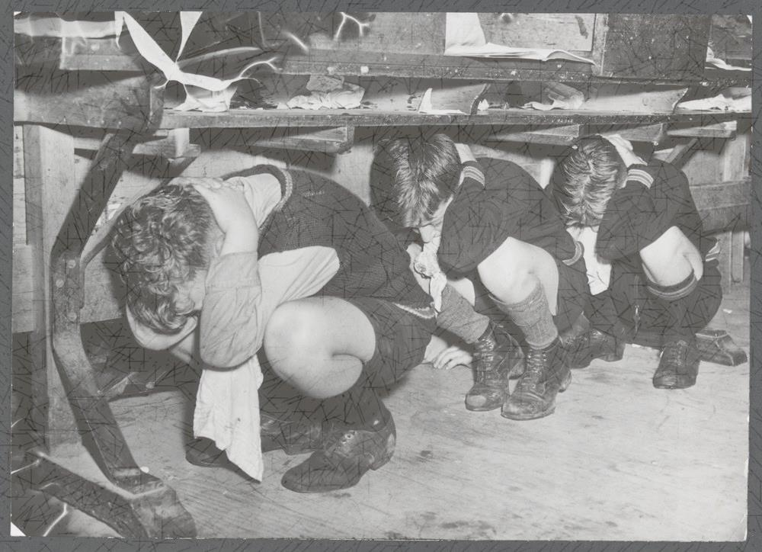
Do you think this duck and cover technique could be effective?

Slide 14
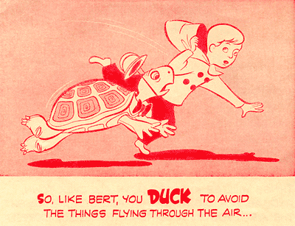
The answer is…
While this (or any) tactic would be useless for someone at ground zero during a surface burst nuclear explosion, it would be beneficial to the vast majority of people who are positioned away from the blast

Slide 15
Tests are Intimidating
Nuclear weapons tests are experiments carried out to determine the effectiveness, yield, and explosive capability of nuclear weapons.

Slide 16
To answer your questions…
Testing nuclear weapons can yield information about how the weapons work, as well as how the weapons behave under various conditions and how personnel, structures, and equipment behave when subjected to nuclear explosions.

Slide 17
Look What We Can Do!
Nuclear testing has often been used as an indicator of scientific and military strength, and many tests have been overtly political in their intention. The country is showing their power.
In fact, most nuclear weapons states publicly declared their nuclear status by means of a nuclear test.

Slide 18
Exiled from Home
Bikini islanders and their descendants have lived in exile since they were moved for the first weapons tests in 1946 as part of the Cold War Arms Race. US nuclear experiments in the Marshall Islands ended in 1958 after 67 tests.
But 60 years later the islands are still unlivable with “near-irreversible environmental contamination” and exiled islanders saying they are too fearful to ever go back because of nuclear contamination. .

Slide 19
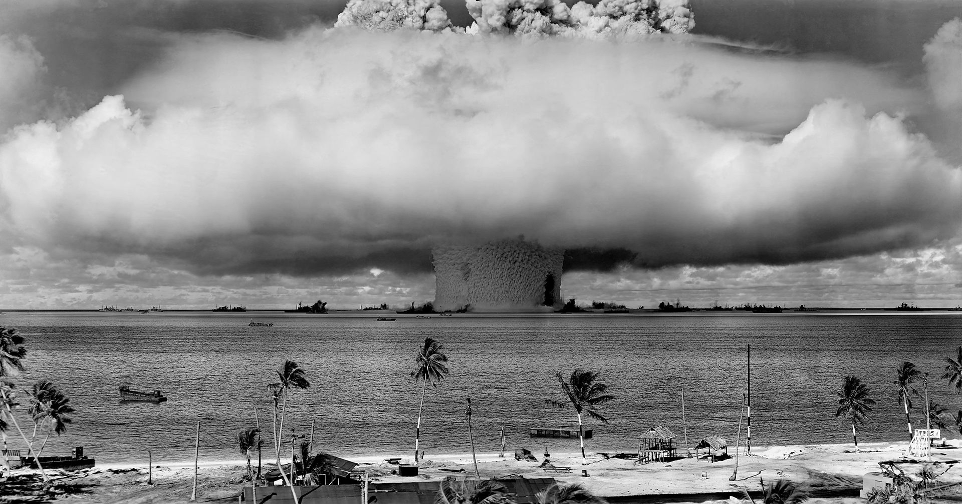
Notes:
The "Baker" explosion, part of Operation Crossroads, a nuclear weapon test by the United States military at Bikini Atoll, Micronesia, on 25 July 1946. The wider, exterior cloud is actually just a condensation cloud caused by the Wilson chamber effect, and was very brief. There was no classic mushroom cloud rising to the stratosphere, but inside the condensation cloud the top of the water geyser formed a mushroom-like head called the cauliflower, which fell back into the lagoon (compare with this image, a photo taken slightly later, after the condensation cloud had cleared). The water released by the explosion was highly radioactive and contaminated many of the ships that were set up near it. Some were otherwise undamaged and sent to Hunter's Point in San Francisco, California, United States, for decontamination. Those which could not be decontaminated were sunk a number of miles off the coast of San Francisco.

Slide 20
Testing, Testing…
Part of the intense cold war nuclear arms race, the 15-megatonne Bravo test on 1 March 1954 by the US was a thousand times more powerful than the atomic bomb dropped on Hiroshima. It vaporized one island and exposed thousands in the surrounding area to radioactive fallout.
Watch the five min film The Deadly Miscalculation at Castle Bravo (HD) by the UnMuseum
https://www.youtube.com/watch?v=yjiWBkiBZQU

Slide 21
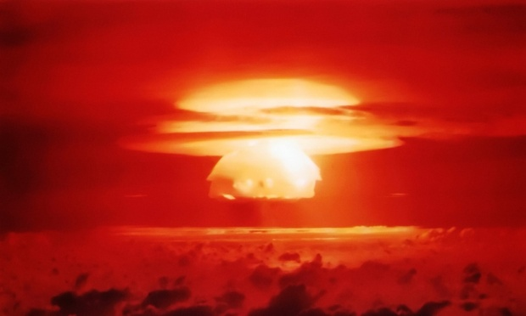

Slide 22
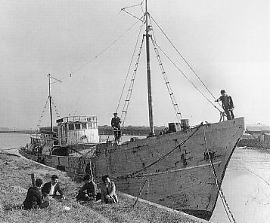
Not So Secret
It was planned as the first test of Operation Castle (a longer series of tests of various devices). Unexpected fallout from the detonation—intended to be a secret test—poisoned the crew of Daigo Fukuryū Maru ("Lucky Dragon No. 5"), a Japanese fishing boat, and created international concern about atmospheric thermonuclear testing.
Daigo Fukuryū Maru in early 1950s, shortly before the incident.

Slide 23

[Don’t] Eat Your [Radioactive] Vegetables!
When US government scientists declared Bikini safe for resettlement some residents were allowed to return in the early 1970s. But they were removed again in 1978 after ingesting high levels of radiation from eating foods grown on the former nuclear test site.
Notes:
Image via: Sodahead.com http://www.sodahead.com/fun/you-accidentally-eat-some-radioactive-vegetables-they-were-good-and-whats-even-cooler-is-that-the/question-1850225/

Slide 24
We Didn’t Mean To Hurt You
The US embassy in Majuro said on its website: “While international scientists did study the effects of that accident on the human population unintentionally affected, the United States never intended for Marshallese to be hurt by the tests.”

Slide 25
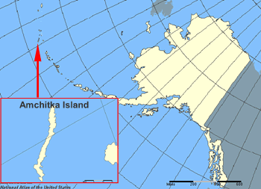
Remote Testing
During the 1960s, the United States Atomic Energy Commission (AEC) conducted nuclear tests on Amchitka Island near Alaska. Despite being designated as a national wildlife refuge by President William Taft in 1913, Amchitka was chosen as a nuclear testing site by the AEC.

Slide 26
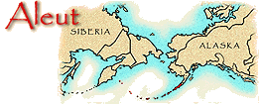
Why?
There were several reasons for this decision. Firstly, Amchitka was close to the former Soviet Union, making it an ideal location for a nuclear test to intimidate the latter with a demonstration of power. However, the public reason given by the AEC was the island's remoteness.

Slide 27
Unhappy Locals
Forceful objections were raised against the testing by a number of organizations and groups, most notably the Aleut people, residents on nearby islands, who were concerned about radiation leaks as well as potential physical damage resulting from the nuclear tests.
Notes:
Image Via: Aleut - Arctic Studies Center www.mnh.si.edu map of Aleut settlement areas

Slide 28
Testing, 1…2…3
In 1965, the Long Shot nuclear test was executed by the Department of Defense. Almost immediately, fallout from the nuclear test began to leak into adjacent freshwater lakes, although details of this contamination were not made public until four years later [1969.]

Slide 29
Not such a good test ground
On October 2, 1969, the AEC executed a test shot underground to determine whether the island would still be a safe place for future tests.
However, this test triggered earthquakes and landslides, and sent water from lakes flying 50 feet (15 m) up into the air.

Slide 30

Not Going to Stop
In 1970, the AEC announced plans for another test, named Cannikin. The environmental movement, then in its infancy, vehemently opposed the testing, and filed a suit in the United States Supreme Court to stop the testing. This motion was denied by a 4 to 3 vote.
Notes:
Image via: www.namm.org All Rights Reserved

Slide 31
Going Underground
On November 6, 1971, the Cannikin bomb was detonated, creating a 60 feet (18 m) deep crater in the island, killing 1,000 sea otters and thousands of birds. The blast was 385 times bigger than that created by the Hiroshima bombing, and was the largest underground test of a nuclear weapon in history.
https://www.youtube.com/watch?v=rtH0EDLcbwA

Slide 32
Effects
The ground lifted 20-25 feet, caused by an explosive force almost 400 times the power of the Hiroshima bomb.
Subsidence and faulting at the site created a new lake, over a mile wide. The explosion caused a seismic shock of 7.0 on the Richter scale (used to rate the amount of energy an earthquake releases), causing rockfalls and turf slides of a total of 35,000 square feet (3,300 m2).

Slide 33
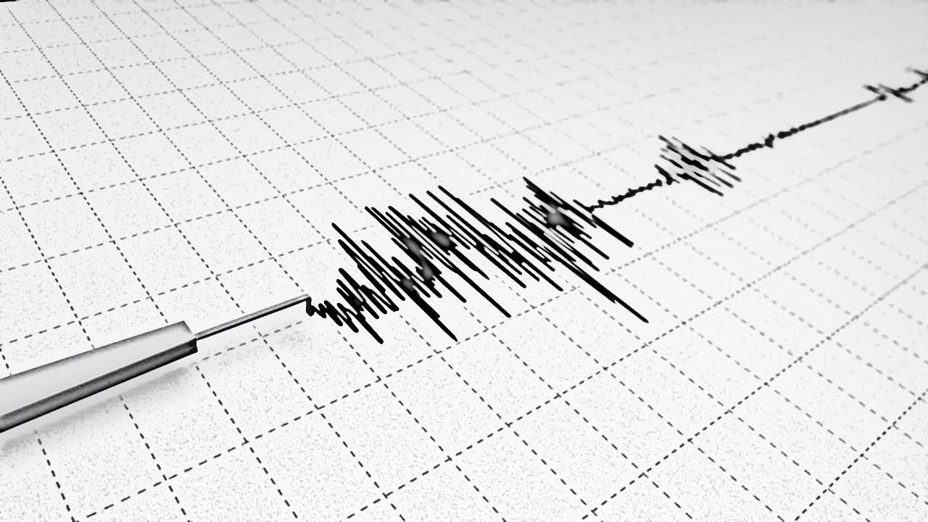
Aftershocks
Though the huge earthquakes and tsunamis feared by some environmentalists didn’t happen, a number of small tectonic events did occur in the following weeks, (some registering as high as 4.0 on the Richter scale)

Slide 34
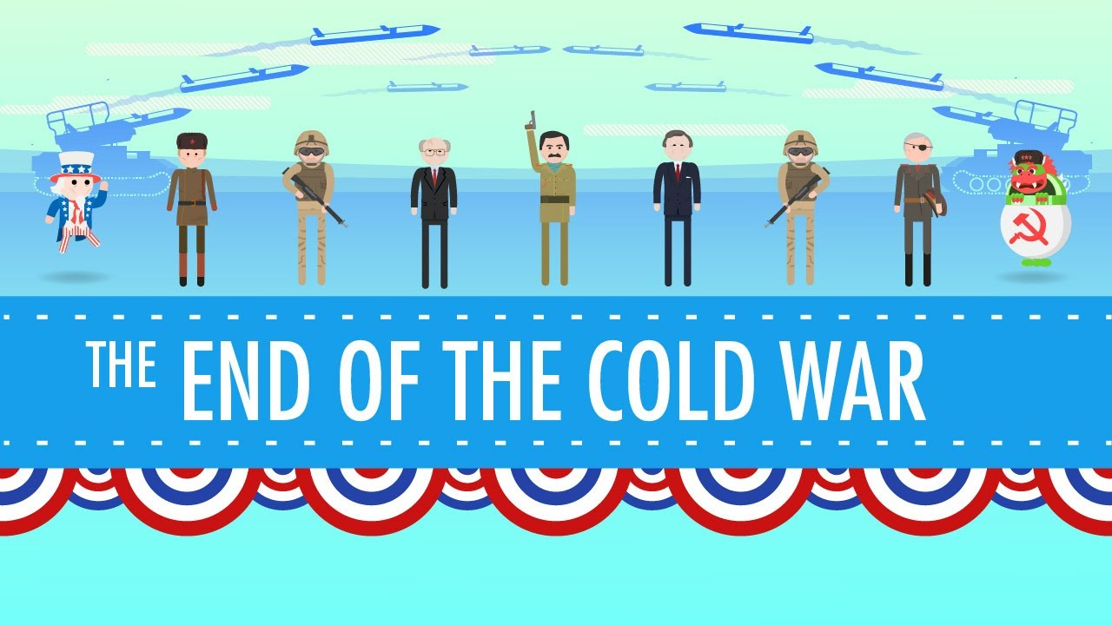
Let’s All Just Relax a Bit
During the 1970s and '80s, tensions began to ease somewhat. Then the Berlin Wall fell in 1989, followed by the collapse of the Soviet government itself two years later. The Cold War officially ended.
Notes:
Image via: www.youtube.com George HW Bush and the End of the Cold War: Crash Course US History #44 https://www.youtube.com/watch?v=L-K19rVDxoM

Slide 35
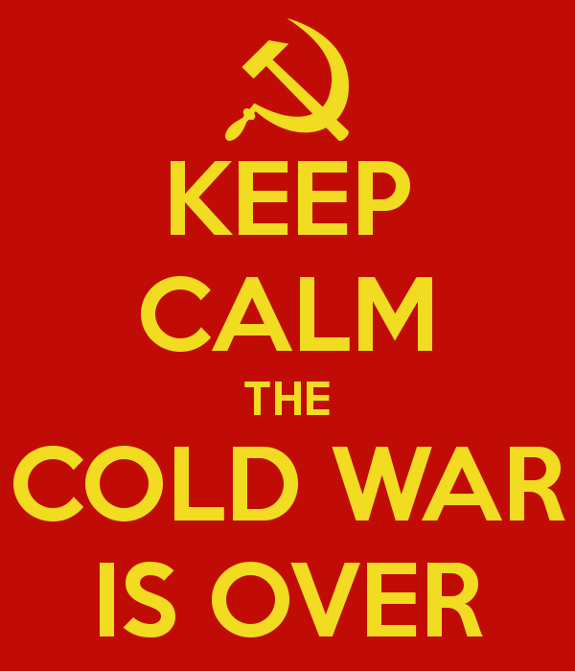
Lowering Our Weapons
As relations between the two countries improved, a commitment to limit nuclear arsenals emerged. A series of treaties followed, aiming to further reduce and limit strategic arms. Among other measures, it calls for an aggregate (combined) limit of 1,550 warheads.
Notes:
Image via: boardgamegeek.com

Slide 37
The Top Nine
Unfortunately, even as Russia and the U.S. step tentatively away from the brink of nuclear power, the threat of nuclear warfare remains.
Nine countries can now deliver nuclear warheads on ballistic missiles. At least three of those countries -- the U.S., Russia and China -- could strike any target anywhere in the world.

Slide 38
Which countries have nuclear weapons today?
There are an estimated 20,000 warheads in the world's combined stockpile of nuclear weapons, controlled by nine countries.
Of these, almost 5,000 are considered operational and about 1,800 to 2,000 belonging to the US and Russia are believed to be kept continually on high-alert status – ready to be launched within minutes of a warning.

Slide 39
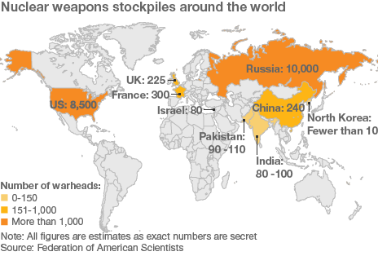

Slide 40
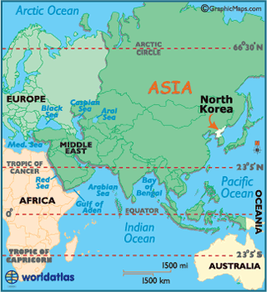
Grasping for Power
In 2009, North Korea successfully tested a nuclear weapon as powerful as the atomic bomb that destroyed Hiroshima. The underground explosion was so significant that it created an earthquake with a magnitude of 4.5.

Slide 41
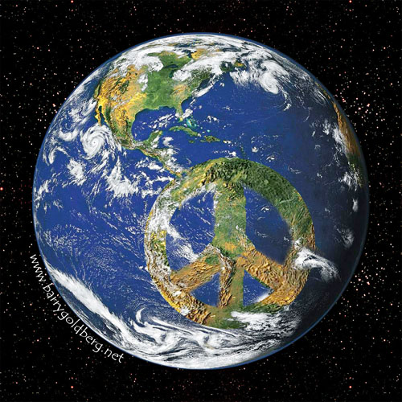
A Weapons Free World?
The failure of the nuclear powers to disarm has heightened the risk that other countries will acquire nuclear weapons.
They want to be world powers too. The only guarantee against the spread and use of nuclear weapons is to eliminate them without delay.

Slide 42

We will!…someday
Although the leaders of some nuclear-armed nations have expressed their vision for a nuclear-weapon-free world, they have failed to develop any detailed plans to eliminate their arsenals and are modernizing them.
No one wants to be the first one to disarm.

Slide 43
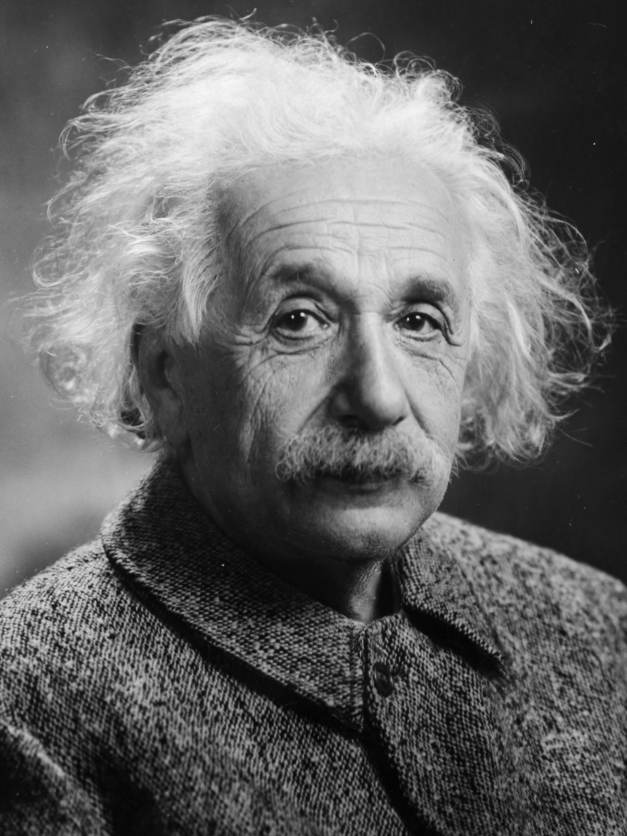
While the political landscape of nuclear warfare has changed considerably over the years, the science of the weapon itself -- the atomic processes that unleash all of that fury -- have been known since Einstein
The discovery of nuclear chain reactions need not bring about the destruction of mankind any more than did the discovery of matches. We only must do everything in our power to safeguard against its abuse."
--Albert Einstein

